Slide 1
4th Grade Lesson 5 Spelling Words
Homophones

Slide 2
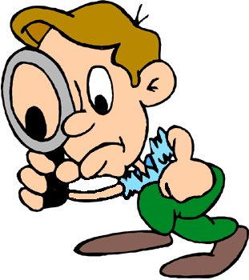
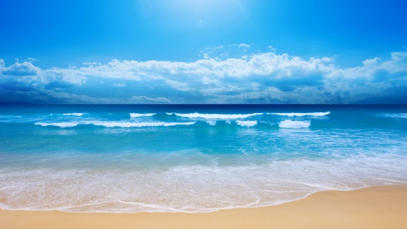
Homophones
Homophones are words that sound the same, but are spelled differently and have different meanings.
Use spelling and context clues to figure out which meaning of the word is being used when you read or hear a homophone.
see - sea -

Slide 3
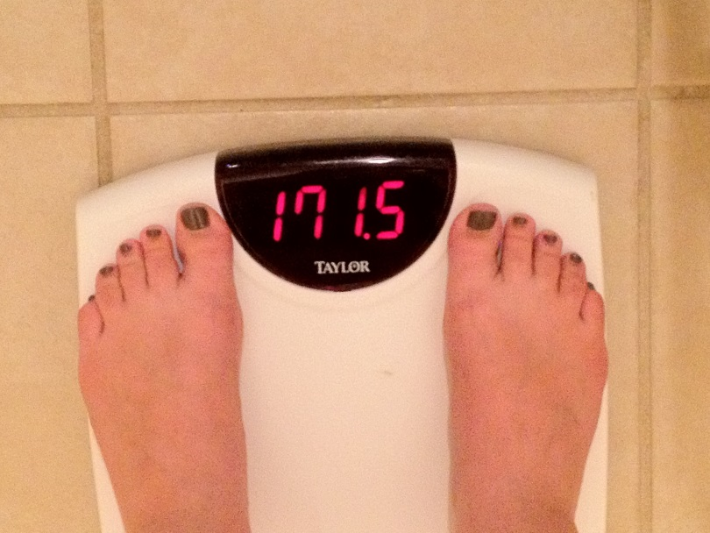
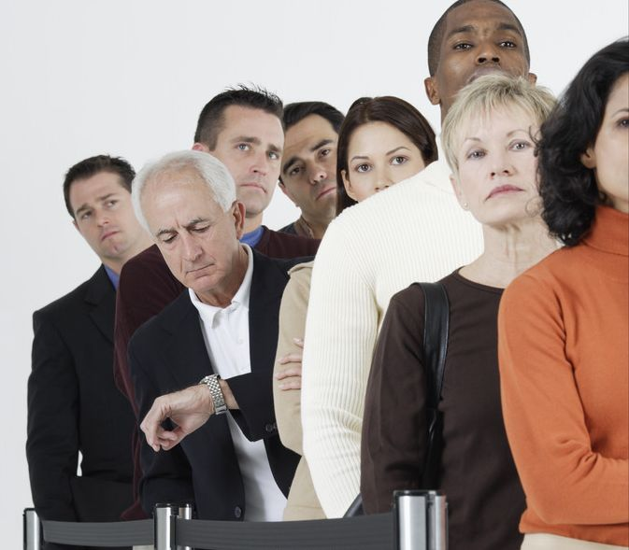
weight/wait
Your weight is how many pounds you weigh.
No one likes to wait in a long line.

Slide 4
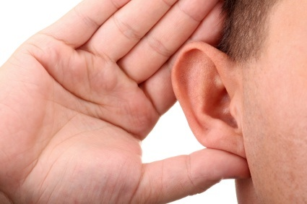
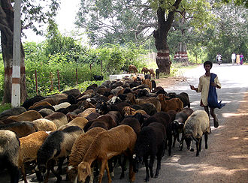
heard/herd
I finally heard what you said when you spoke loud enough.
A big group of sheep, cows or many other animals is called a herd.

Slide 5
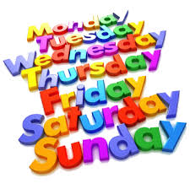
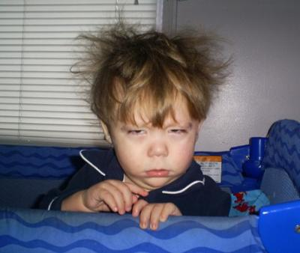
days/daze
There are 7 days in a week.
Sometimes when you first wake up, you feel like you are in a daze and you don’t know what’s going on.

Slide 6
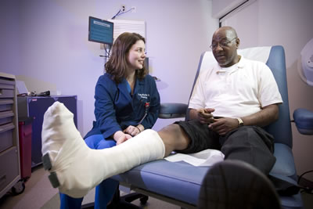
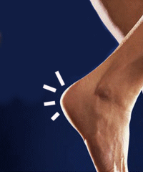
heal/heel
When you break your leg, a cast will help it heal.
Your heel is the back part of your foot.

Slide 7
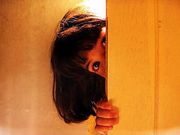
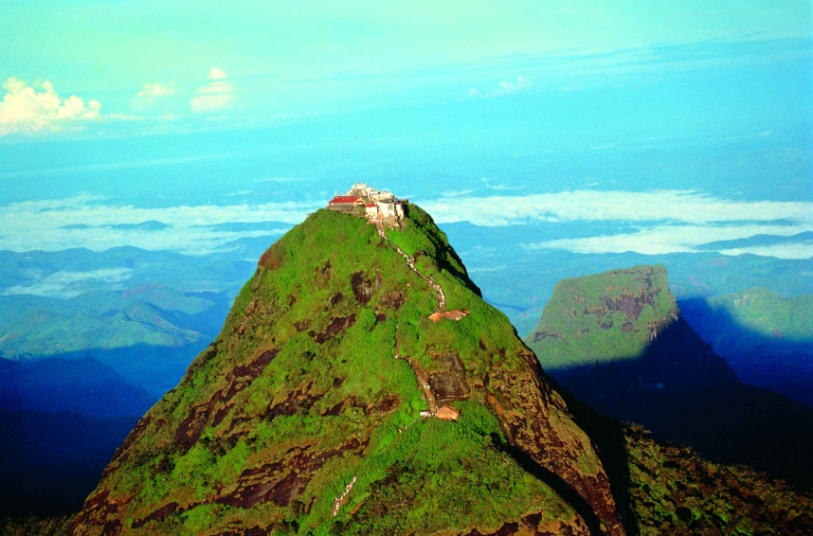
peek/peak
A peek is a quick and usually sneaky look at something.
The peak of a mountain is the very top of it.

Slide 8
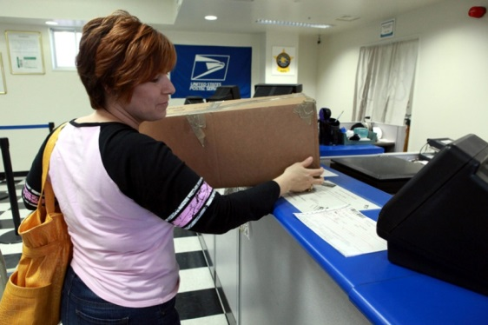
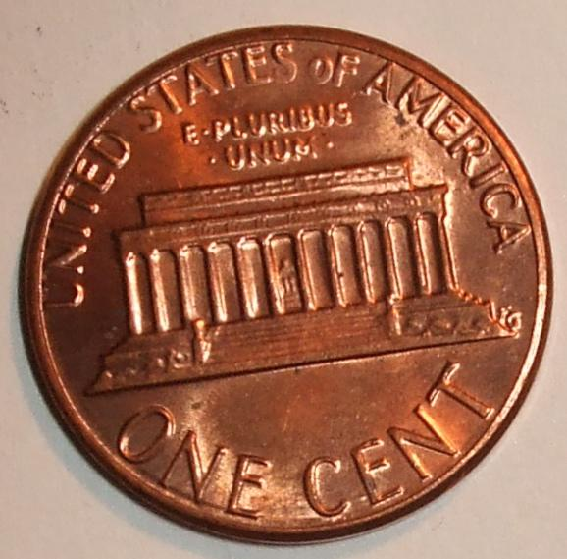
sent/cent/scent
She sent a package to her family in another state.
A penny is one cent.
The scent of the flower was wonderful!

Slide 9
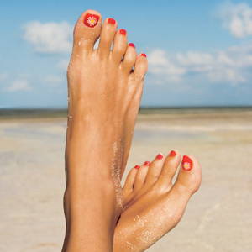
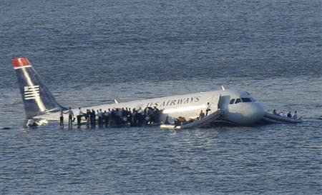
feet/feat
People have two feet.
Landing this plane safely in a river was a great feat! Most pilots couldn’t do it.

Slide 10
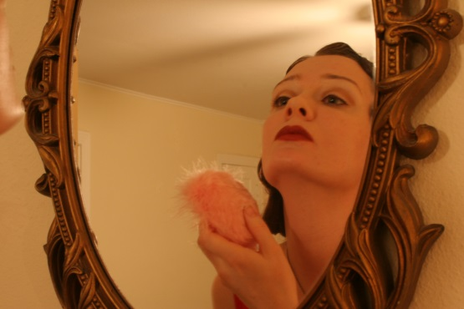
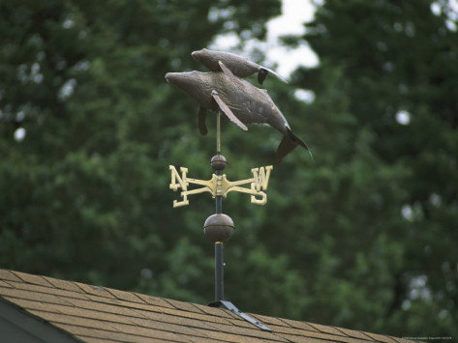
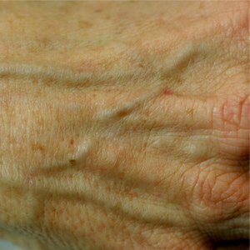
vain/vane/vein
Someone who is vain is always looking in the mirror and is always worried about how they look.
A weather vane tells you which direction the wind is blowing.
A vein is something in your body that helps move your blood around.

Slide 11
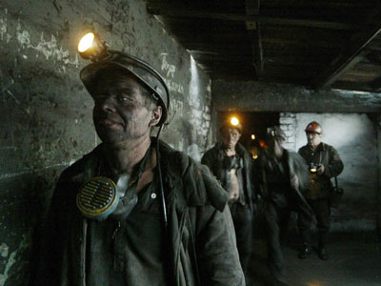
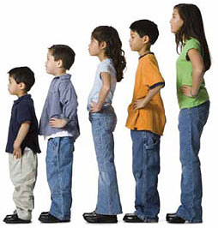
miner/minor
A miner is someone who works in a mine.
You are a minor until your are 18 years old, then you are an adult.

Slide 12
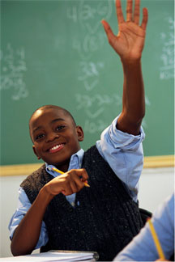
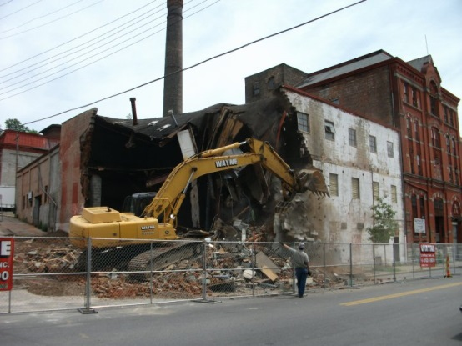
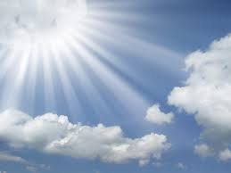
raise/raze/rays
When you are in class, you need to raise your hand before answering.
When you raze a building, your knock it down and destroy it.
The sun’s rays feel nice and warm when they reach you.

Slide 13
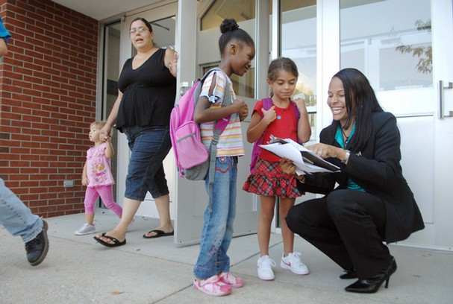
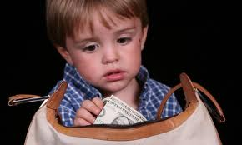
principal/principle
The school principal is in charge of the school.
Asking before you take something is an important principle.

