Slide 1
Because of Winn Dixie
Vocabulary
Unit 1, Lesson 1

Slide 2
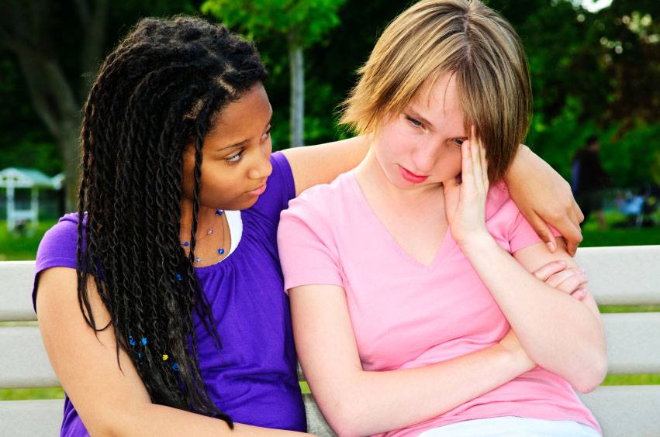
Comfort:
Sometimes you need to comfort a sad friend and try to make them feel better.

Slide 3

Mention:
There are some things you shouldn’t mention and just keep quiet about, especially if it will hurt someone’s feelings.

Slide 4

Mood:
We all feel a different mood in different situations.

Slide 5
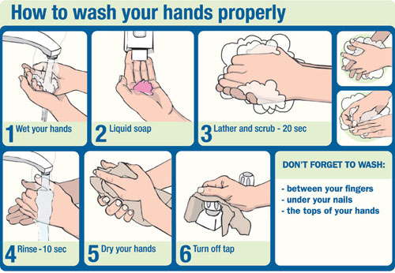
Properly:
It’s important to wash your hands properly so you don’t get sick.

Slide 6
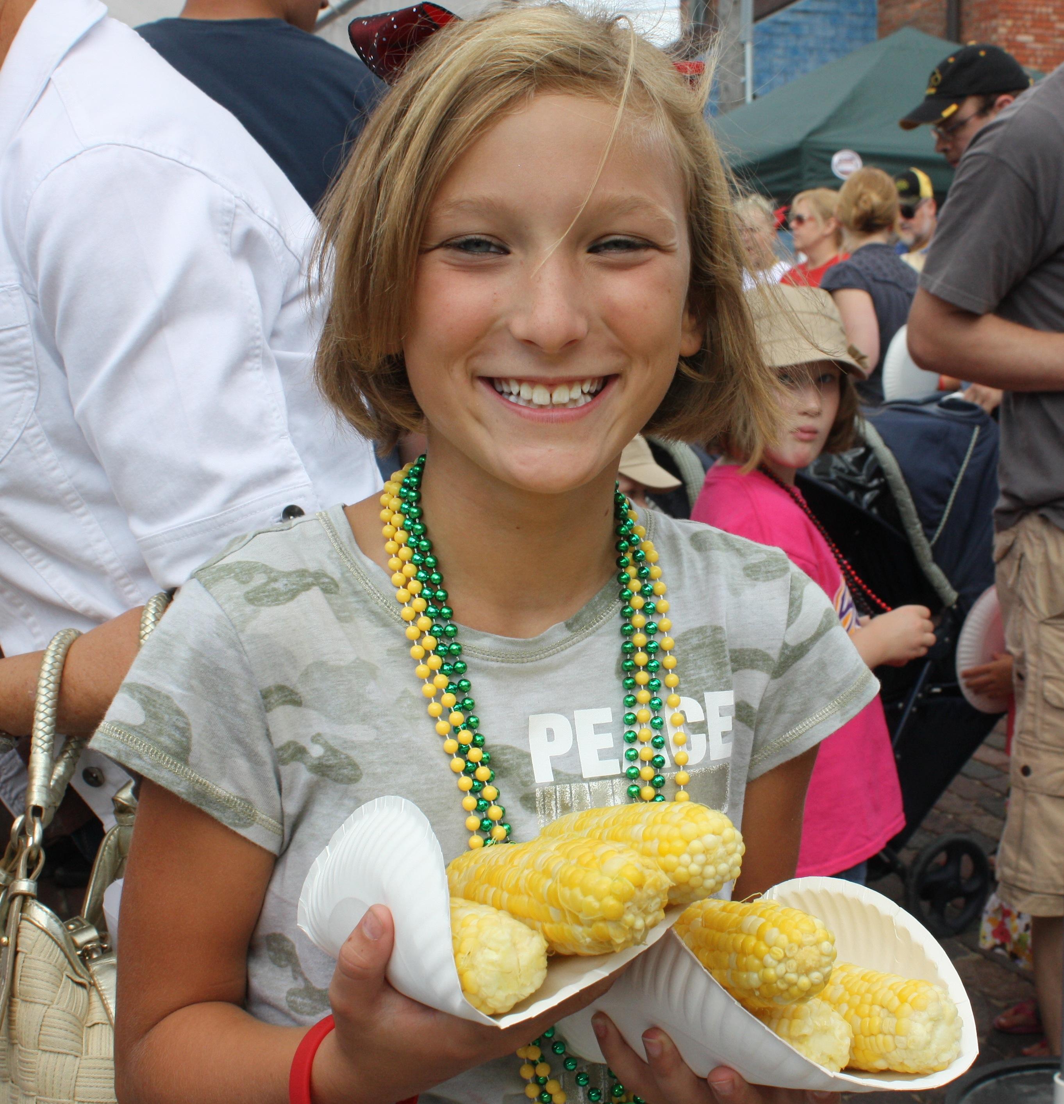
Intends:
She intends to eat sweet corn until her stomach hurts because she loves it so much!

Slide 7
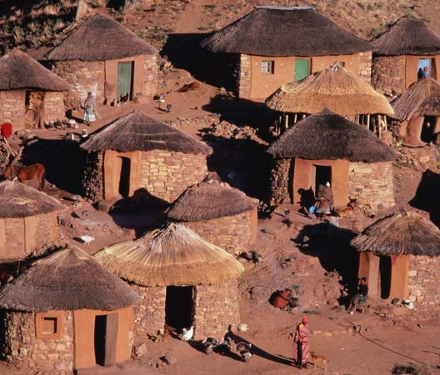
Consisted:
My house in my country consisted of very different materials than my house here.

Slide 8
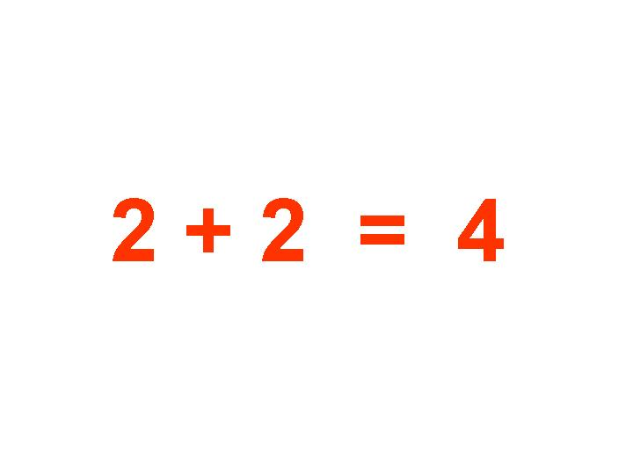
Positive:
I’m positive that 2 plus 2 equals 4!

Slide 9
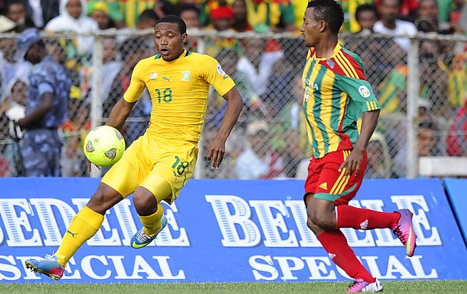
Advanced:
The soccer players in the World Cup play at the most advanced level. There’s no one better.

Slide 10
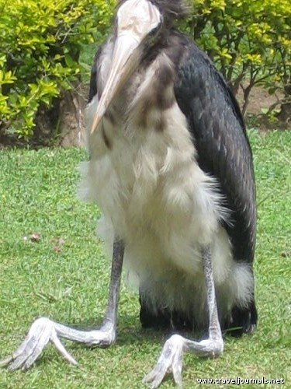
Peculiar:
I’ve never seen this peculiar bird that lives in Indonesia!

Slide 11
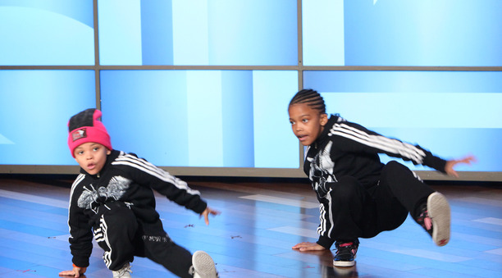
Talent:
These boys have a lot of talent in dancing!

