Slide 1
Donavan’s Word Jar
Chapter 1 and 2 Vocabulary
Lesson 26

Slide 2
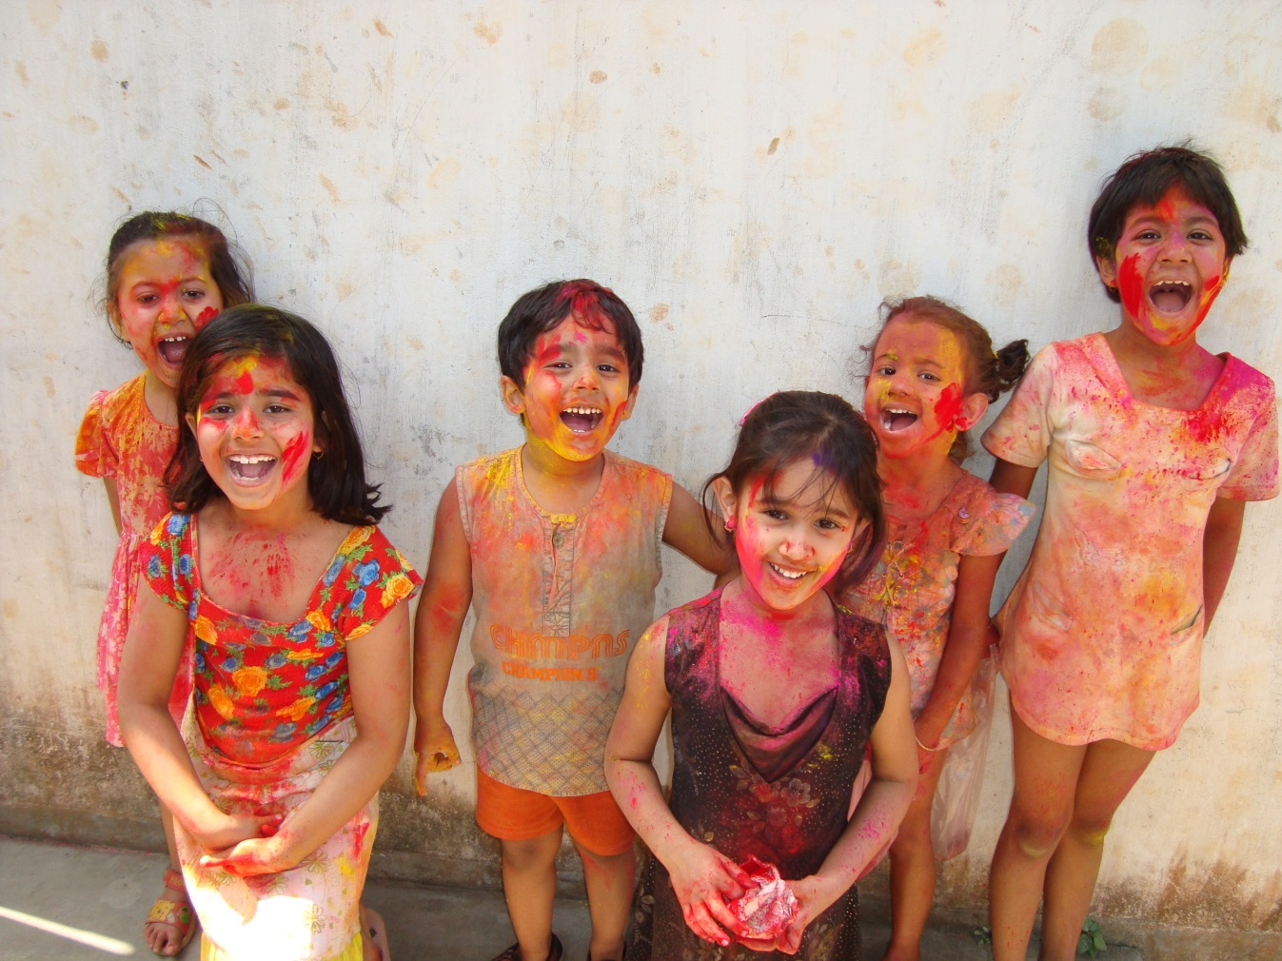
enjoyed
The kids enjoyed the celebration, but it sure was messy!

Slide 3
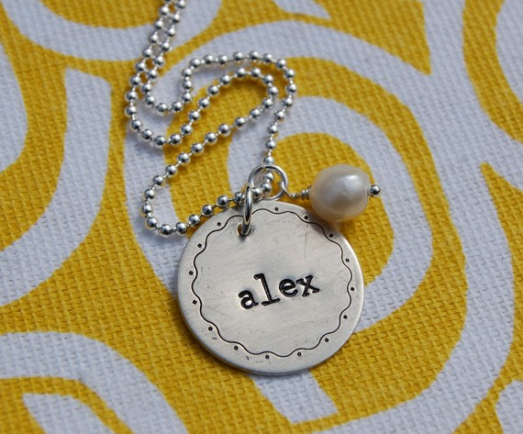
stamped
My name was stamped on the necklace my mom gave me.

Slide 4
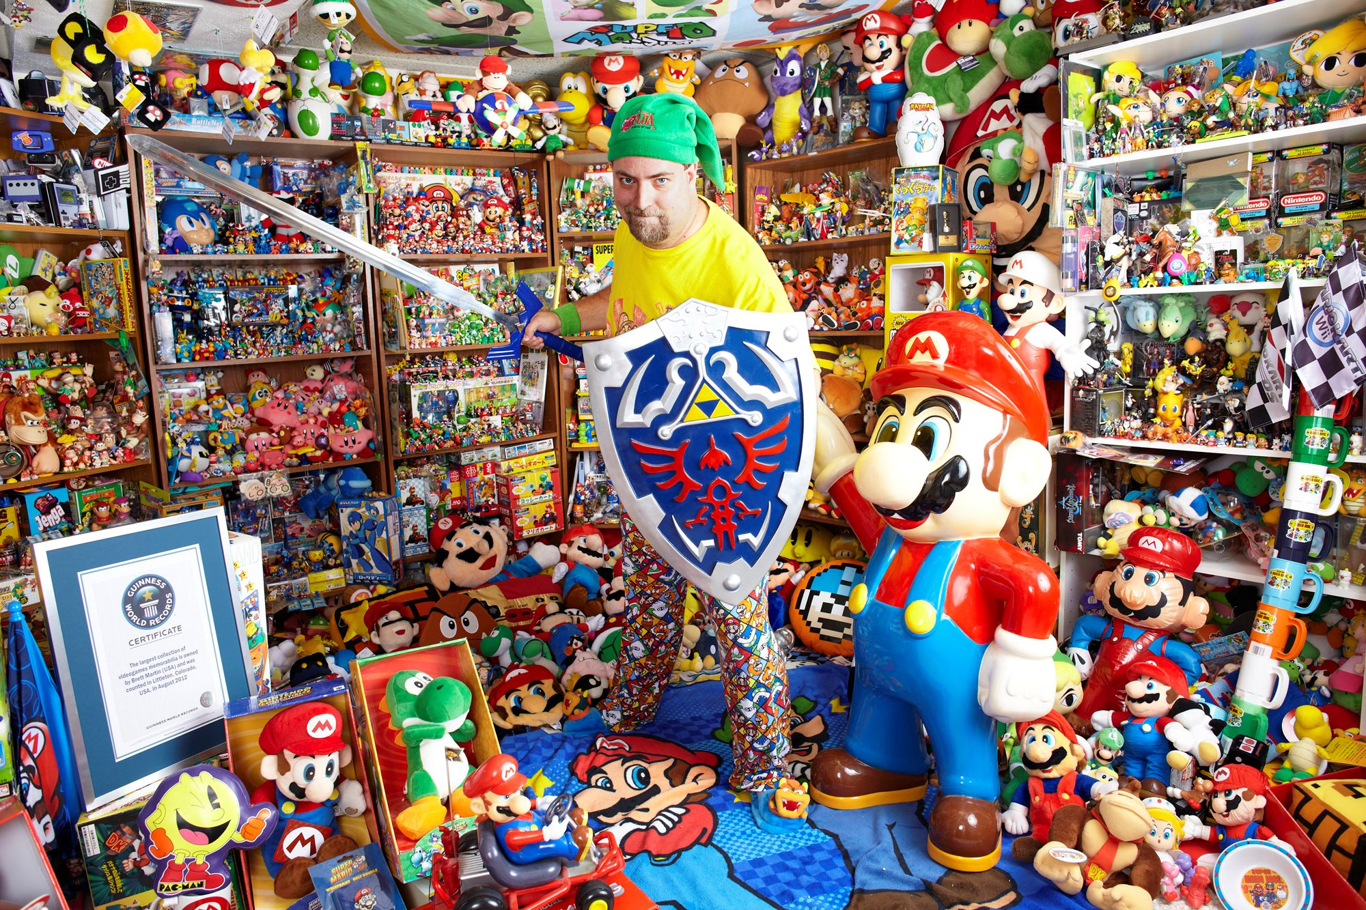
collection
This man has a huge collection of video game toys.

Slide 5
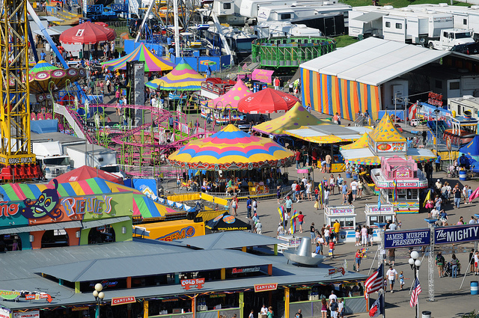
event
There are a lot of fun
events in Des Moines,
especially the Iowa
State Fair!

Slide 6
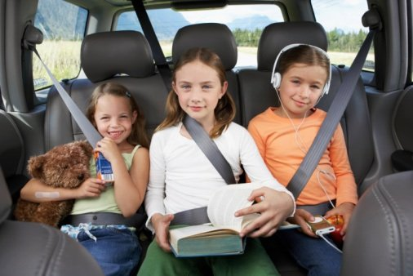
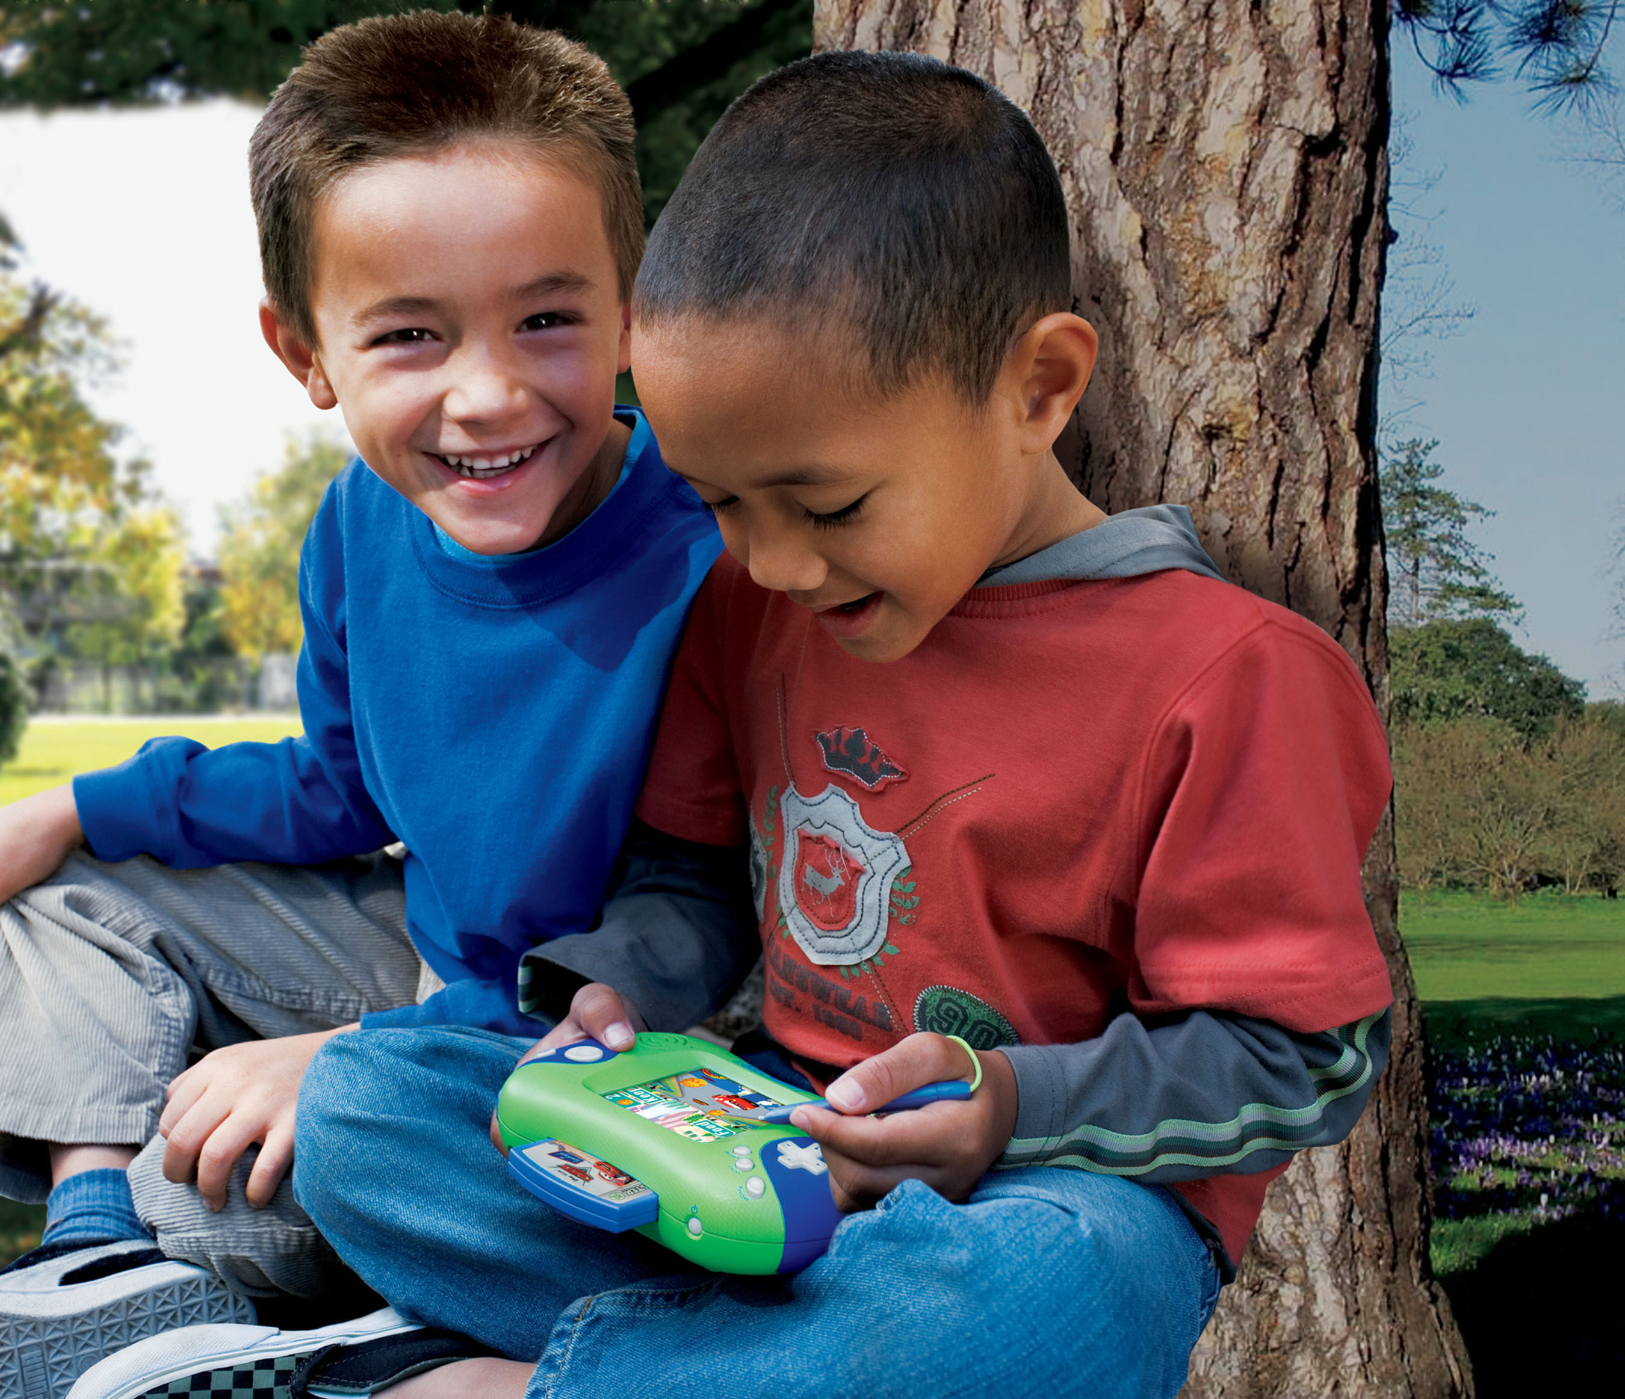
amusement
Kids can do a lot of things for amusement, like read a book, listen to music or play video games.

Slide 7
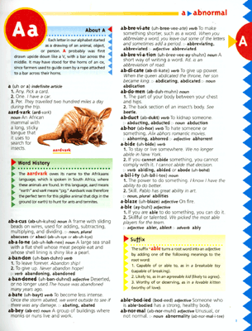
dictionary
A dictionary can help you find out what words mean.

Slide 8
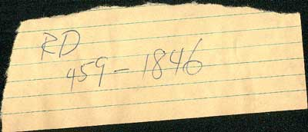
slips
I needed to be careful not to lose the slip of paper I wrote my friend’s phone number on!

Slide 9
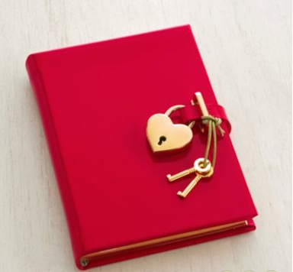
private
A person’s diary or journal is very private. You should never try to read someone else’s diary or journal.

Slide 10
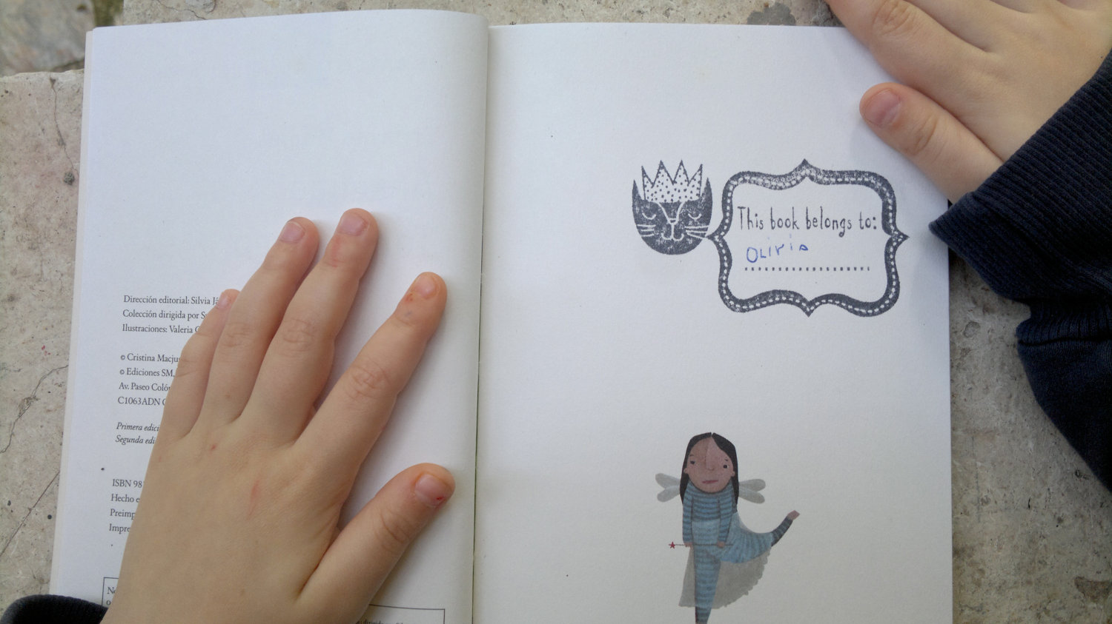
property
I had to ask my sister to borrow her book since it is her property.

Slide 11
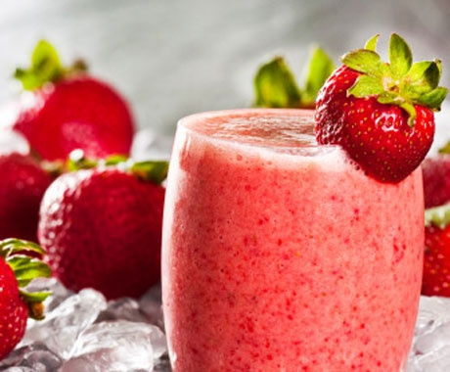
brim
I was happy the smoothie was filled to the brim of the glass, but I had to be careful not to spill it.

