Slide 1
Suffixes -y, -ly and -ful

Slide 2
What are suffixes?
Suffixes are parts of a word that are added at the end of a base word.
They add to the meaning of the base word.
For example, “sandy” means “having sand,” “safely” means “in a safe way” and “hopeful” means “full of hope.”

Slide 3
Let’s Practice!

Slide 4
quickly A cheetah runs quickly. Quickly means: in a __________ way.

Slide 5
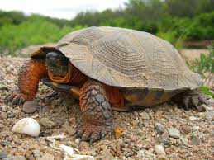
slowly
A turtle walks slowly.
Slowly means: in a ___________ way.

Slide 6
colorful
These are colorful candies.
Colorful means: full of ___________.

Slide 7
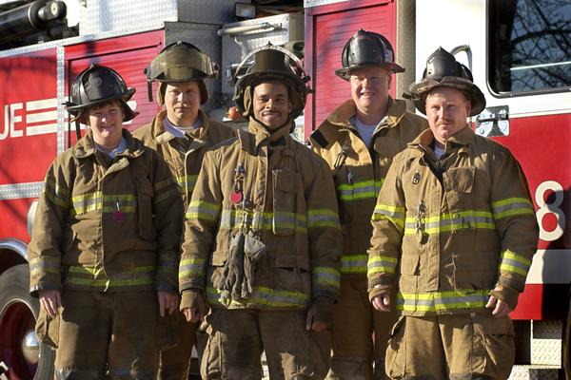
helpful
Firefighters are helpful people.
Helpful means: having a lot of ways to ___________.

Slide 8
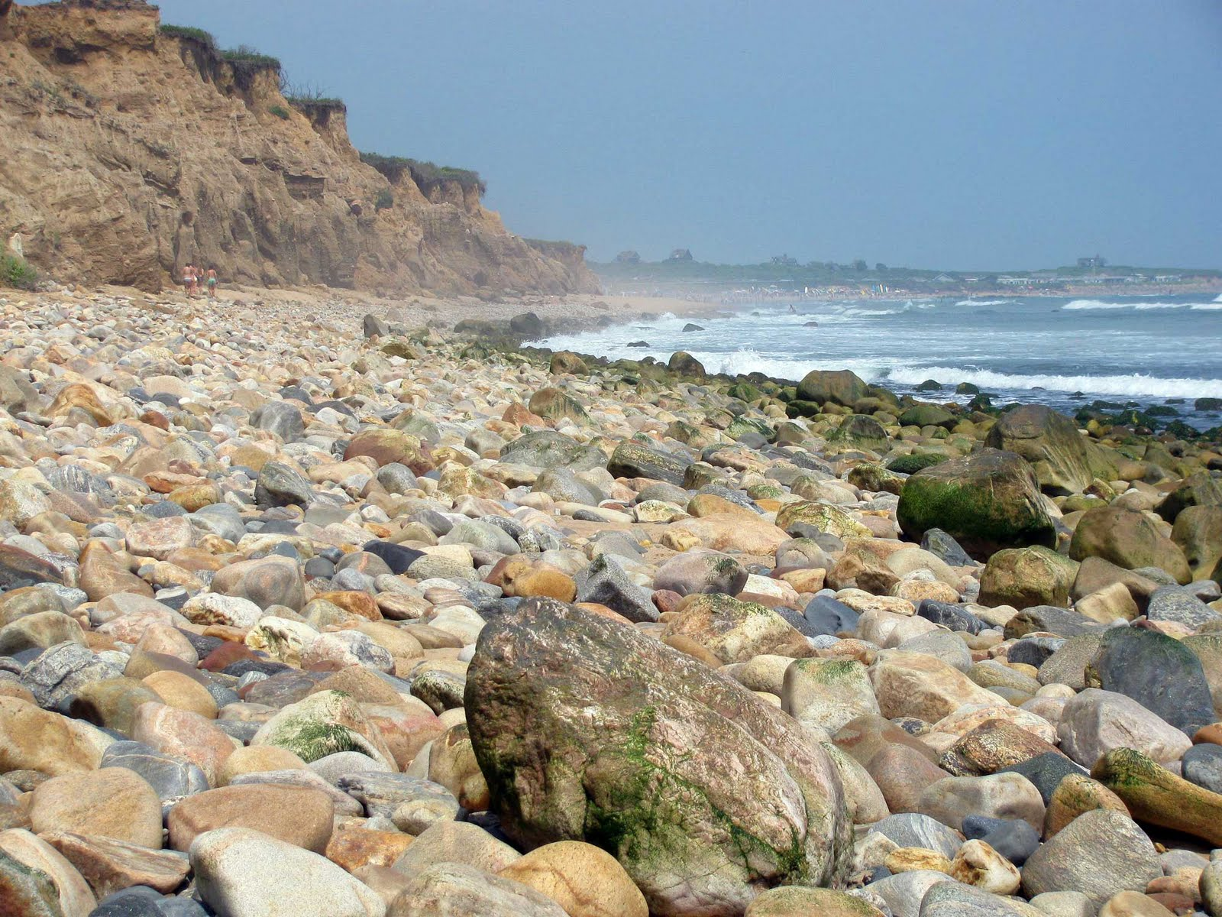
rocky
This beach is too rocky.
Rocky means: having a lot of _______.

Slide 9
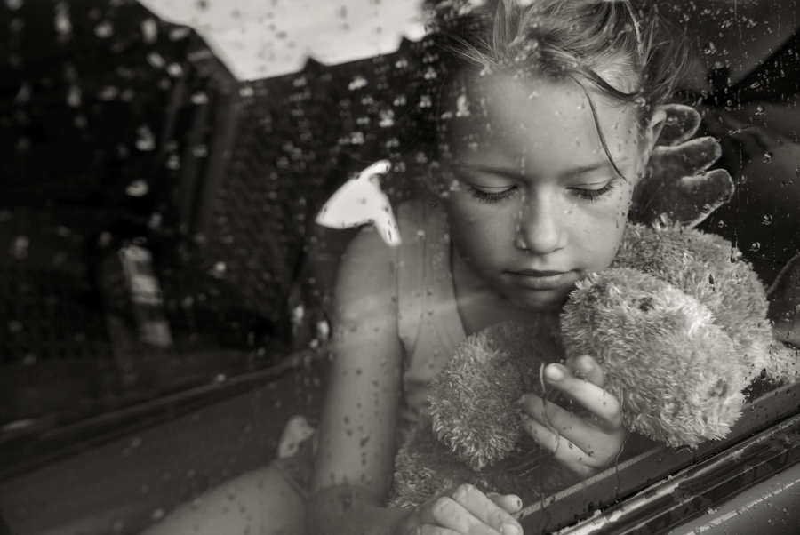
sadly
The girl sat sadly in the car as her family drove away from their old house.
Sadly means: in a ________ way.

Slide 10
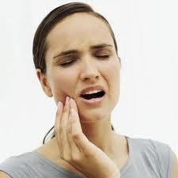
painful
A cavity can be painful.
Painful means: full of ___________.

Slide 11
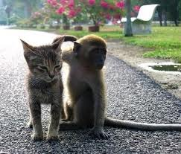
friendly
These two animals are friendly.
Friendly means: in the way of a ______.

Slide 12
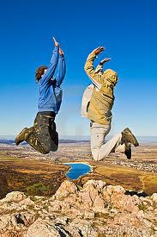
cheerfully
The hikers jumped up cheerfully when they reached the top.
Cheerfully means: in a way that is full of ________.

