Slide 1
Jake Drake, Know-It-All
Chapter 8-9 Vocabulary
Lesson 29

Slide 2
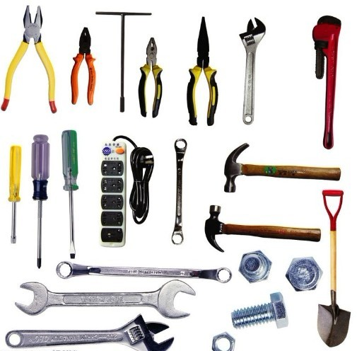
hardware
People who love to build and fix things love to get hardware for presents!

Slide 3
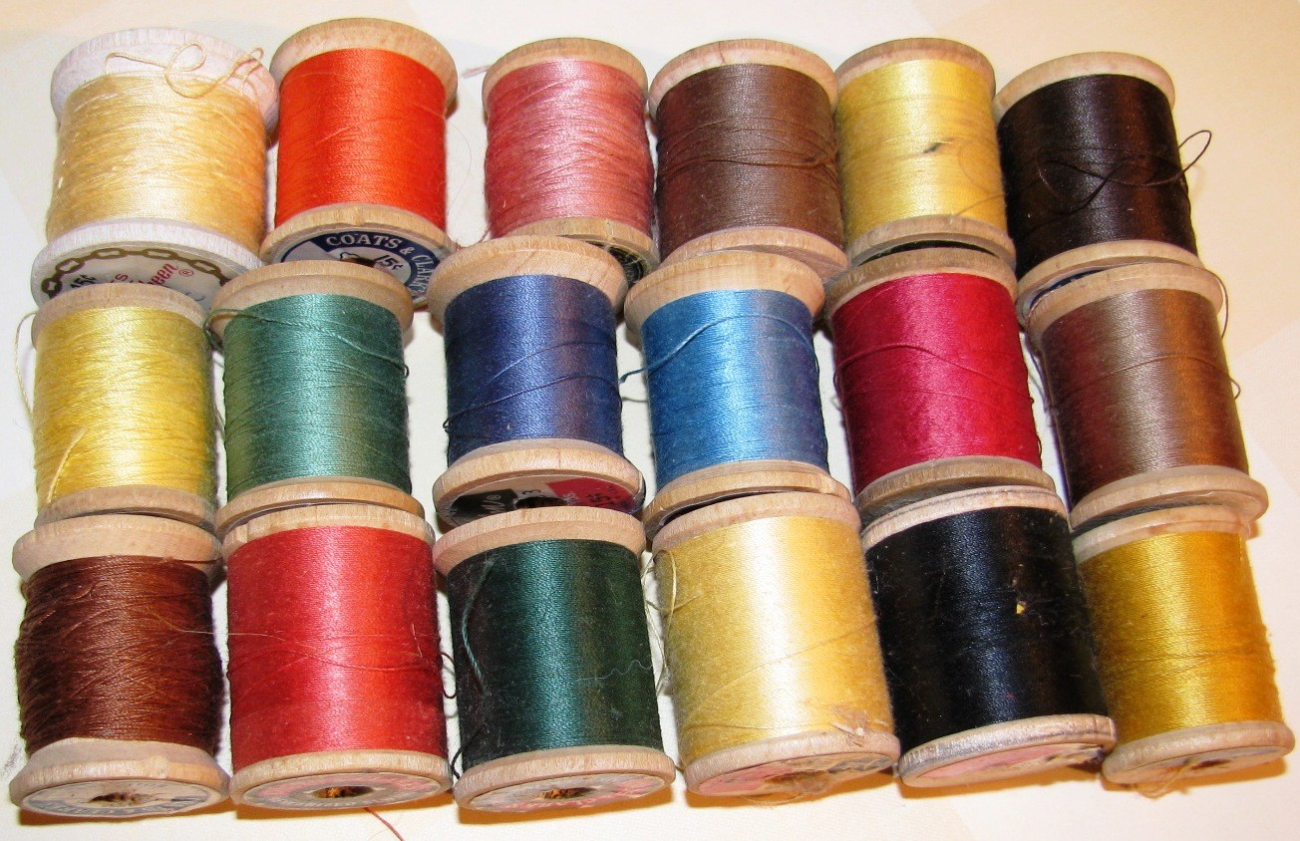
spools
I had a lot of spools of thread so that I could sew something colorful.

Slide 4
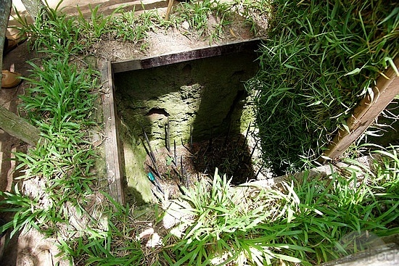
trap
This trap works to catch people because the trap door is covered with grass so people can’t see it and when people step on it, they fall into the pit.

Slide 5
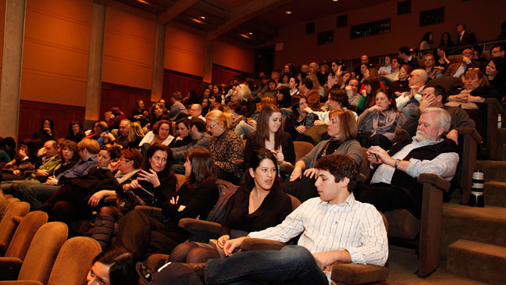
practically
The seats at the show were practically full, but there were a few empty ones in the front row.

Slide 6
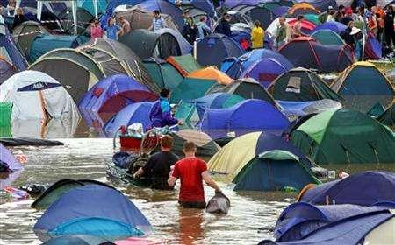
worst
These campers had the worst luck with the weather!

Slide 7
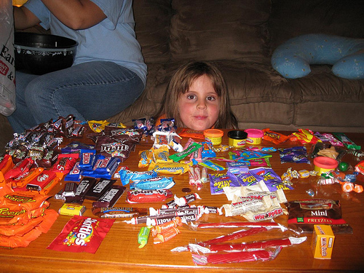
terrific
The little girl looked at all the candy she had gotten trick-or-treating and thought it was pretty terrific!

Slide 8
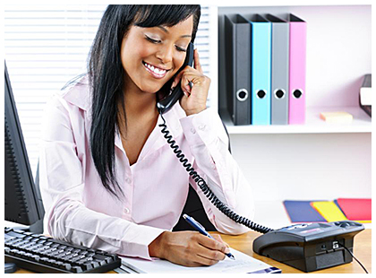
secretary
The lawyer had a secretary to help her answer phone calls and keep her office organized.

Slide 9
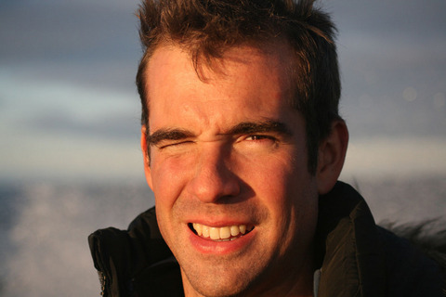
squint
When you look at a bright light, your squint your eyes so you can see.

Slide 10
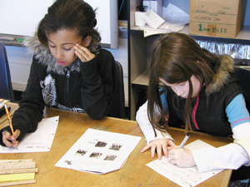
regular
Today was just a regular day at school. Nothing really good or really bad happened.

Slide 11
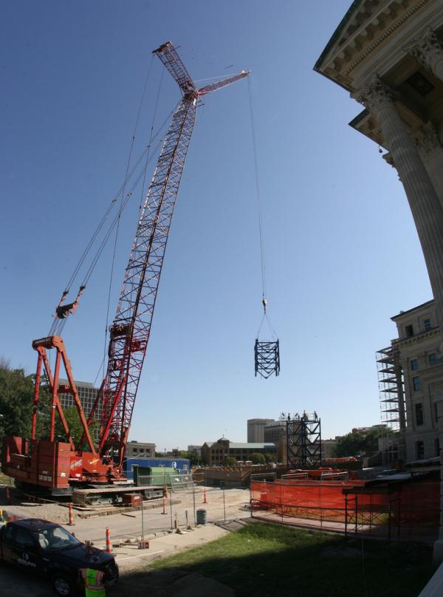
crane
Construction workers use a crane to lift something really heavy to a place up high.

